Slide 1







Cupid’s
Bakery
Cupid’s
Bakery
Presented by:Group 2

Slide 2







GROUP MEMBERS
Zynnx(Designer/coder)
Lily(Designer/coder)
Demo(Designer/coder)
Nol Nol(Leader/Coder)
01

Slide 3






CUPID’S BAKERY WEBSITE
Cupid’s bakery
The website you can order testy & sweet cakes, many types of desserts and drinks
˚ʚ♡ɞ˚
02

Slide 4
References
Apps and websites
Canva
ChatGPT
Youtube
Pinterest
Winkapp
Uifresh
Crumbl cookies
Chubbies by ash
02

Slide 5



OBJECTIVES OF OUR WEBSITE
Can order plenty of sweet and creamy cakes and desserts.
Whatever you want to order from our website you can choose delivery or pick up. Just make a choice!
You can taste and feel the richness of our pastries.
Because we bake with love and serve with smiles.
Various menus and decorations will make you hard to choose what you want to eat.
03

Slide 6

BENEFITS
Our website will fulfil your hunger!
Since we created a bakery website, the main one we want to make you is mouthwatering (៸៸›ᴗ‹៸៸ ).
Of course you can get any types of cakes, desserts or drinks whenever you feel hungry.
Always welcome you to our website with
loves of cupids!
:¨ ·.· ¨:
· . ꔫ
04

Slide 7
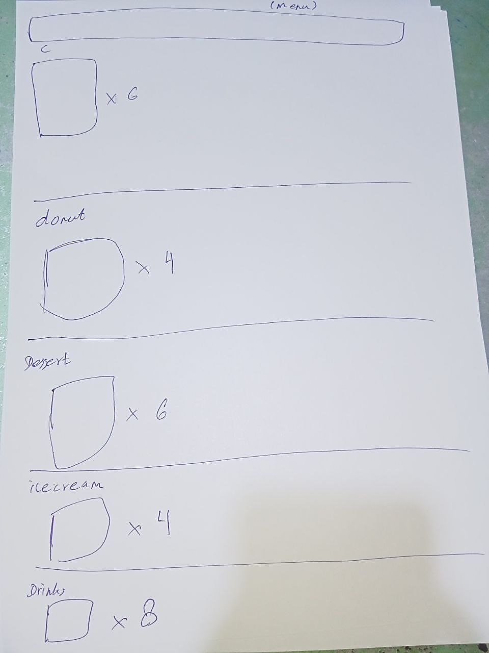
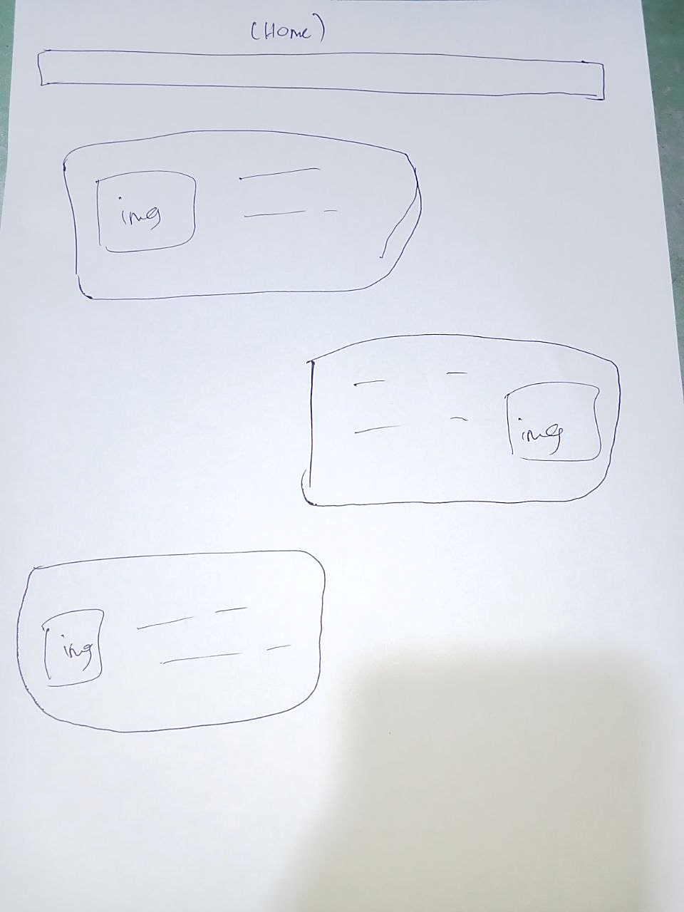
Wireframe
02
01
05

Slide 8


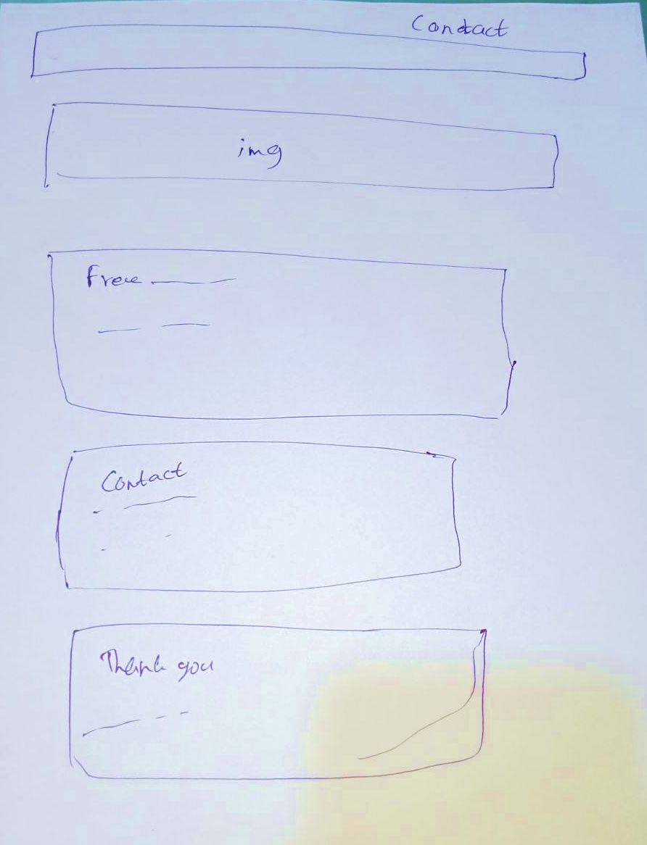
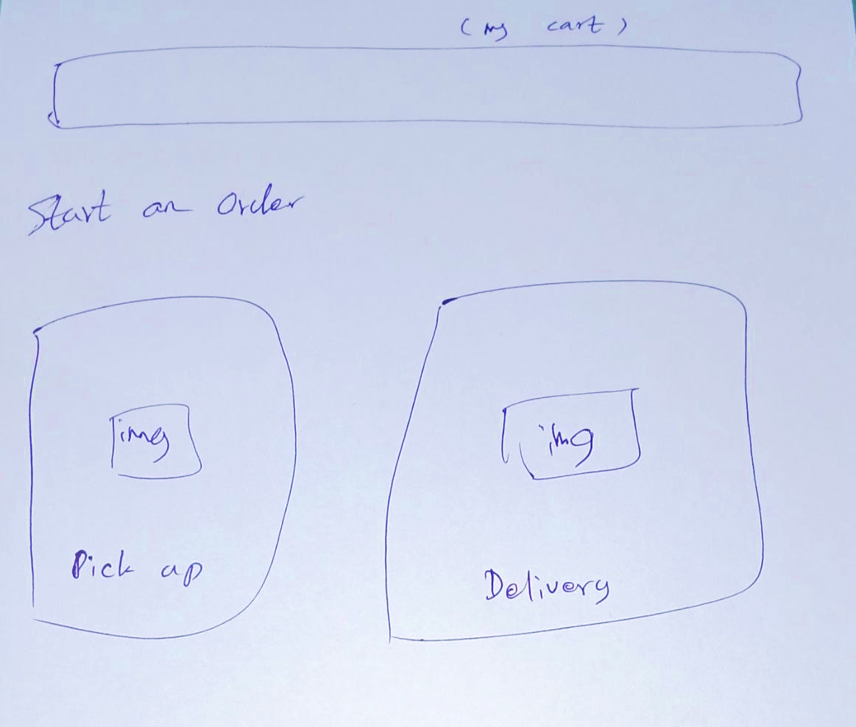
Wireframe
03
04
06

Slide 9

CONCLUSION
This is all about what you can do or see
in our website.
Hope you find interest in this project.
Lastly, thanks to our group members for working unity. Matching energy essentially is one of the key words for TEAM WORK!
07

Slide 10
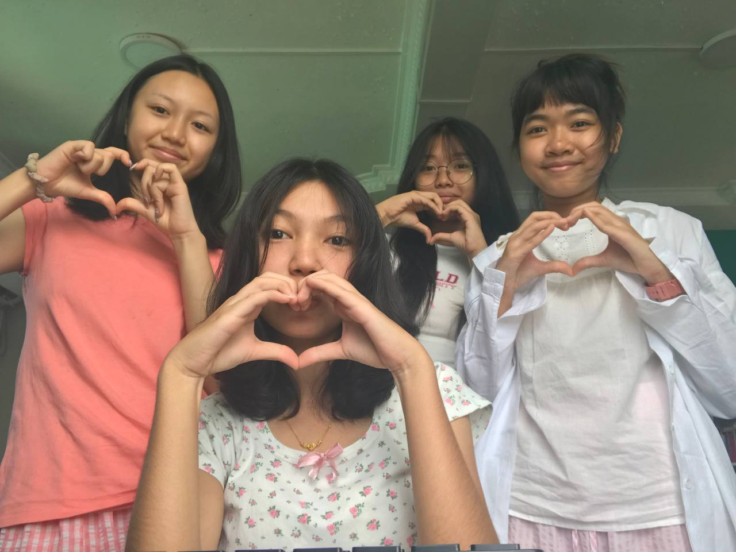
Our Group

Slide 11

THANK YOU
THANK YOU

